Slide 1
Angular Universal
Christoffer Noring, Softhouse

Slide 2
Concepts and History
Spike Brehm from AirBnb coined the term Isomorphic javascript
shared code between the client and server
Michael Jackson suggested calling it Universal Javascript

Slide 3


The following existing frameworks support isomorphic/universal view rendering at some level
create wrappers around all the core Backbone objects.
An app uses Rendr.view instead of Backbone.view, Rendr.collection
instead of Backbone.collection, etc. There are also a set of server specific libraries
Meteor core does not have server rendering, so accordingly there is no mechanism to transfer state from server rendered views to the client
it is possible to set up server rendering with Meteor
BUT
Core principle states,
“Meteor doesn't send HTML over the network”
However, Blaze is used for template rendering and
there is a project that adjusts blaze for server rendering
https://github.com/meteorhacks/meteor-ssr
Uses handlebars, serializes state
Tightly coupled to express
React
Using npm packages
react + react-dom we can achieve server side rendering
BUT server rendering solution is relatively slow because the server
doesn’t optimize using pre-compile templates or caching

Slide 4

Problems with heavy SPA, single page applications
SEO a lot of our pages are dynamic.. There are solutions but NOT out of the box
Progressive enhancement
Link preview
> 3 sec….. Cya
Initial page load of a client app
Server response
Asset downloads
Client init
Client data
Rendering
3 -7 sec

Slide 5
How to Approach the 3 sec
Serve you app in pieces,
lazily as they are accessed like AMD and requirejs
OR
Application
Server side render a first page that you serve the user
while client downloads the rest in the background and client takes over when done
Server view displayed
Client being bootstrapped
Client takes over
Its all about perception
Server responds with a
fully rendered page
User sees it
User can interact with it for real

Slide 6
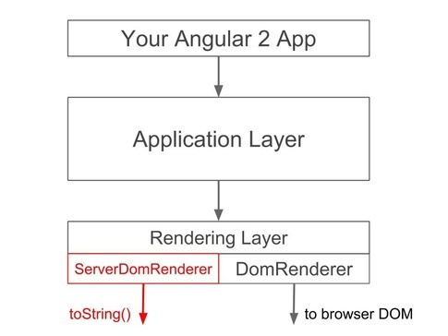
Overview angular 2
separate the rendering layer from the overall application layer
The rendering layer provides a common protocol for performing UI updates
1
2
JsonRenderer?

Slide 7

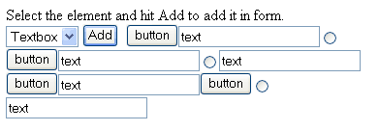
Preboot ( small piece of javascript included in the server view )
Server page is alive but the client isnt there YET…
how to handle user events… click drag and what not?
1
2
3
Click
Click
Enter text
blur
Client (angular) wakes up
and processes events
Instantly rendered
Instantly functional
Instantly awesome
Preboot, Records events

Slide 8
Angular Universal History
June 22nd 2015, Angular U https://angularu.com/VideoSession/2015sf/angular-2-server-rendering
Oct 2015 Full Stack Angular 2 - AngularConnect, https://www.youtube.com/watch?v=MtoHFDfi8FM
Jan 2016 Angular Universal read the source https://www.youtube.com/watch?v=qOjtFjXoebY
Angular 2 server rendering design doc,
https://docs.google.com/document/d/1q6g9UlmEZDXgrkY88AJZ6MUrUxcnwhBGS0EXbVlYicY/

Slide 9




Angular Universal - core project
https://github.com/angular/universal
564 stars ,
26 contributors
Core members:
Patrik Stapleton
Jeff Whelpley
Tobias Bosch
Jeff Cross

Slide 10
Starter kit
Installing
Different branches
git clone https://github.com/angular/universal-starter
npm install --global typescript typings webpack nodemon
npm install
Default branch with webpack
Systemjs branch
Angular Connect branch
Running
npm start
npm run build
npm run watch
build your client app and start a web server
prepare a distributable bundle
build your client app and start a web server
Code in angular 2
Install server plugin
For different server side approaches

Slide 11
Going from Client to Server Side
Normal app
angular2-universal-preview
Files/ libs needed for serverside rendering
Where you setup your
View engine in nodejs ( angular2 )
Where you bootstrap
Your starter file
Where you app lives
server.ts
client.ts
index.html
app.ts

Slide 12
Server.ts – setting view engine
Express view engine + angular2
app.engine('.html', expressEngine);
app.set('views', __dirname);
app.set('view engine', 'html');
function ngApp(req, res) {
let baseUrl = '/';
let url = req.originalUrl || '/';
res.render('index', {
directives: [App],
providers: [
provide(APP_BASE_HREF, {useValue: baseUrl}),
provide(REQUEST_URL, {useValue: url}),
ROUTER_PROVIDERS,
NODE_LOCATION_PROVIDERS,
],
preboot: true
});
}
// Serve static files
app.use(express.static(root));
Express with handlebars
Engine setup
Thats it!!
var express = require('express');
var exphbs = require('express-handlebars');
var app = express();
app.engine('handlebars', exphbs({defaultLayout: 'main'}));
app.set('view engine', 'handlebars');
app.get('/', function (req, res) {
res.render('home');
});
app.listen(3000, function () {
console.log('Example app listening on port 3000!');
});
Respond to route
setup App as top
Component +
setup routing
app.use('/', ngApp);

Slide 13
Run code demo
function ngApp(req, res) {
let baseUrl = '/';
let url = req.originalUrl || '/';
res.render('index', {
directives : [ App ],
preboot: true
});
}
Minimum effort to turn it serverside, well plus engine setup and
app.use('/', ngApp);

Slide 14


Thank you for listening
https://www.linkedin.com/in/christoffer-noring-3257061
chris_noring

